Slide 1
Operationalizing the Principles of Inclusive Emergency Management
March 10, 2022
L. Vance Taylor Chief, Office of Access and Functional Needs (OAFN) California Governor’s Office of Emergency Services (Cal OES)

Slide 2
Access and Functional Needs (AFN)
Individuals who have:
Developmental, intellectual or physical disabilities
Chronic conditions or injuries
Limited English proficiency
And/or…
Individuals who are:
Older adults, children or pregnant
Living in institutionalized settings
Low income, homeless and/or transportation disadvantaged

Slide 3
Office of Access and Functional Needs (OAFN)
Established in 2008 to identify the needs of people with disabilities, older adults, and all Californians with access and functional needs before, during, and after a disaster.
OAFN integrates whole community needs and resources throughout emergency management systems and provides guidance to emergency managers, planners, service providers, partners, stakeholders, etc.

Slide 4
Principles of Inclusive Emergency Management
Integration
Bringing people to the table
Understanding needs
Making room for everyone
Partnership
Working together
Creating buy-in
Earning credibility
Synergy
Building community
Achieving more together

Slide 5
The Mission: Mega Vaccination Pilot Sites
Cal OES and FEMA were mission-tasked by the Administration to pilot two mega vaccination sites
Vaccines were to be administered equitably with a focus on underserved communities
The pilots were to create a blueprint for standing up mega vaccination sites nationwide

Slide 6
Principle #1: Integration – Bringing People to the Table to Understand and Address Needs
Establishing Equity Focus
Including AFN stakeholders
Identifying and addressing needs
Accessibility Services
In-person and video language services
DME, tents, privacy rooms, etc.
Free paratransit and shuttles
Mobile Vaccination Clinics
Deployed mobile clinics
Partners identified sites

Slide 7
Principle# 2: Partnership – Working Together to Create buy-in and Credibility
Direct input from the Pacific ADA Center, Disability Rights California, and others
Involved in planning and implementation
Trusted sources to assist with public messaging
Deployed mobile vaccination clinics to CBO-identified locations

Slide 8
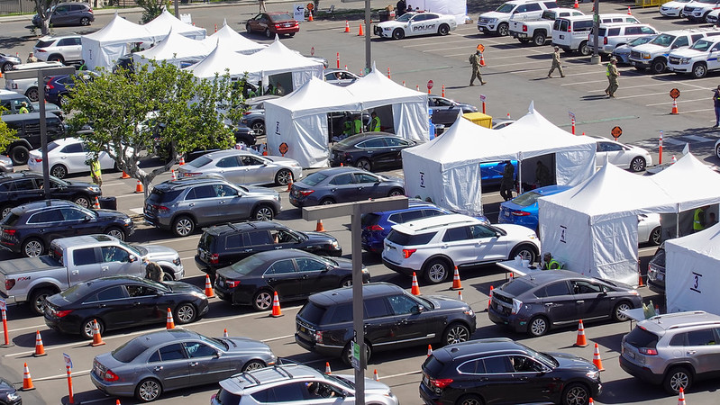
Principle #3: Synergy – Together we Achieve Great Things
Mass Vaccination Sites:
As of April 12thmore than 720,000 vaccines were administered
More than 103,000 administered at mobile clinics within the community
More than 68 percent were administered to targeted underserved communities and people of color

Slide 9
Office of Access and Functional Needs Thank you
L. Vance Taylor
Chief, Office of Access and Functional Needs (OAFN)
California Governor’s Office of Emergency Services (Cal OES)

Slide 10
Pacific ADA Seminar Kern County Inclusive Emergency Management March 10, 2022
Georgianna Armstrong, Emergency Manager
Kern County Fire Dept – Office of Emergency Services
Email: Garmstrong@kerncountyfire.org Phone: 661-873-2604

Slide 11
Kern County Emergency Management AFN Projects
County of Kern’s ability to effectively plan for inclusive emergency response dependent upon interaction with key stakeholders:
Independent Living Center of Kern County
Community Action Partnership
BGLAD
Ombudsman
CalOES – OAFN

Slide 12
Kern County Emergency Management AFN Projects
Working with community organizations provides:
Subject matter expertise that government may lack
Enhanced response capability

Slide 13
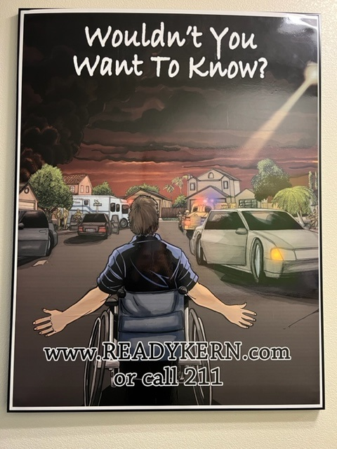
Kern County Emergency Management AFN Projects
Alert & Warning: “ReadyKern”
Targeted outreach
Campaign graphics
Multi-language
Targeted Public Service Announcement
Smart 911

Slide 14
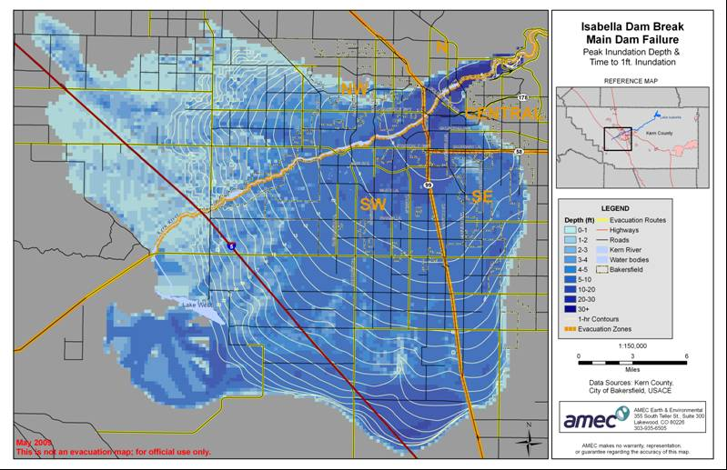
Kern County Emergency Management AFN Projects Evacuation Transportation
2009: Isabella Dam Failure Evacuation Plan
Stakeholder planning group failed to address AFN evacuation needs

Slide 15
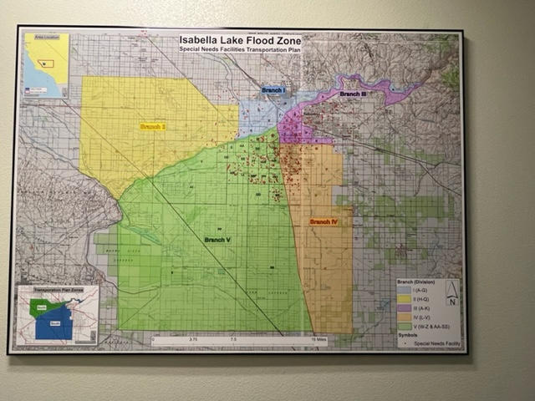
Kern County Emergency Management AFN Projects Evacuation Transportation
Transportation providers into ICS structure
Development of database of facilities
Designated bus service pickup locations

Slide 16
County of Kern: AFN Disaster Response Evacuation Transportation
Aging & Adult Services Hot Line
Coordination with EOC
Transportation resource providers:
Kern Regional Transit
Kern Superintendent of Schools (MOU)
GET (MOU)

Slide 17
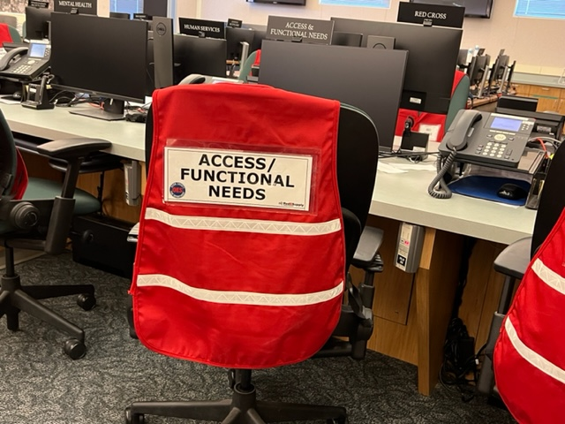
Disaster Response Management Structure
Established AFN Position
in Kern EOC
Operations Section
Kern County Aging &
Adult Services Dept
Video incident updates with ASL interpretation

Slide 18
Partnership with Community Organizations
Grant Funds to Sponsor:
Independent Living Center of Kern County
Start up funding to expand ASL services available locally
Community Action Partnership of Kern County
Trusted source to provide community preparedness information to Spanish
speaking and/or lower income community
BARC
Equipment for targeted training to use 911 and ReadyKern

Slide 19
Grant Funds for Inclusive Emergency Response
FEMA Grant Programs Directorate
Information Bulletin No. 361 (May 13, 2011)
Directs integrating needs of persons with Access & Functional Needs into local Homeland Security and emergency preparedness programs

Slide 20
Grant Funds for Inclusive Emergency Response
Authorized Equipment List (AEL) to allow grant funds to be used to purchase equipment and supplies for:
19AF-01-CHLD Infants & Children
19AF-01-COMM Communications & Sensory Support
19AF-01-FEED Feeding Support
19AF-01-HYGN Personal Hygiene
19AF-01-MOB Mobility Support
19AF-02-BACC Service Animals Bedding & Accessories
19AF-02-RELF Service Animals – Relieving Station

Slide 21
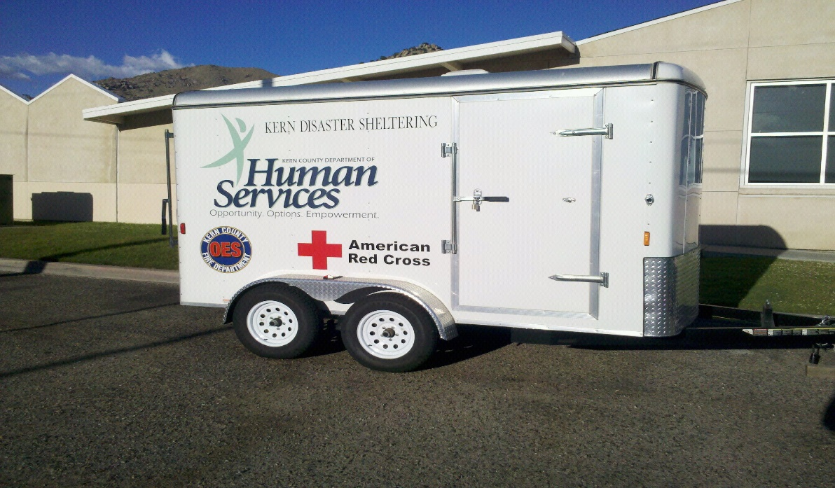
County of Kern: AFN Disaster Response Mass Care Shelters – Equipment Trailers
ADA compliant cots
Hoyer lift/sling
Wheelchair, cane, walker
Threshold ramps
Bedside commode
Privacy curtain
Portable playpen/bassinet
Diapers/wipes (adult & child)
Shower bench & wheelchair
Accessible shower tools
Audio guard / lights
Magnifiers / scrolling signage
Disposable earplugs
Cell phone chargers
Service Animal supplies
UbiDuo & Laptop computer
Portable refrigerator (medication)

Slide 22
County of Kern: AFN Disaster Response Mass Care Shelters – ADA Compliant 2-unit Bathroom/Shower Trailer

Slide 23
County of Kern: AFN Disaster Response Mass Care Shelter SOP
Equal access and support
Acting on client’s words to meet needs
Support customary level of independence
Compliance with Americans with Disabilities Act (ADA)

Slide 24
County of Kern: AFN Disaster Response Mass Care Shelter SOP Focus
Mobility disabilities
Visual impairment
Hearing impairment
Non-English speakers
Limited financial means
Unaccompanied/unsupervised minors
Foster children
Persons without (pre-incident) stable housing
Legally mandated registered individuals

Slide 25
Emergency Preparedness Videos for People with Disabilities
Introduction
Skills Test
Building a Support Team
Emergency Supply Kits
Physical & Mobility Limitations
Low or No Vision
Hearing
All video sections are in English and Spanish languages, captioned, with ASL interpretation Videos hosted on Kern Aging & Adult Services website
(https://www.kerncounty.com/government/aging-adult-services/resources/emergency-preparedness)

Slide 26
Extended Power Outages
Aging & Adult Services: direct contact to medical baseline customers to confirm awareness and requests for assistance
Cache of portable power units for distribution as needed to support persons reliant on critical medical equipment (Kern Public Health Dept)

Slide 27
COVID-19 Vaccine Clinics
Process planning coordination with multiple community providers
Onsite walk-thru with community providers for input on improved process
Real-time, on-demand remote ASL interpretation services provided

Slide 28
Upcoming Projects
Explore process and possibility to maintain real-time, on demand virtual ASL interpretation services Op Area-wide to support field-level first responders (Fire, Law, EMS)
Development of evacuation plans specific to Skilled Nursing Facilities and Assisted Living Centers during disaster response

Slide 29
INCLUSIVE EMERGENCY MANAGEMENT IN NEVADA COUNTY
Carly Pacheco– Executive Director

Slide 30
FREED’s Role in Emergency Management
Work with local OES on emergency planning and sheltering needs
Provide information to consumers on personal preparedness
Sign-up consumers for notification and alert systems- comes from OES relationship
Work with consumers who have lost AT for replacement
Suspend normal intake process during emergency
Temporary housing, transportation, and financial assistance during Public Safety Power Shut Offs

Slide 31
Nevada County
High Fire Threat (all of Nevada County is in Tier 2 or 3)
Winter Storms
Multiple utility companies
Significant Public Safety Power Shut Offs

Slide 32
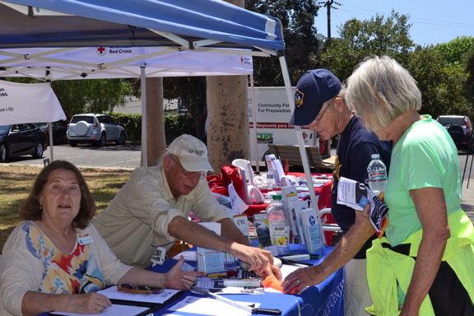
Integration
Established relationship with local OES
Monthly Coordination Meeting
Participate in emergency plan development and trainings
Nevada County ADRC gathering unmet needs
Prioritize AFN and you take care of whole community

Slide 33
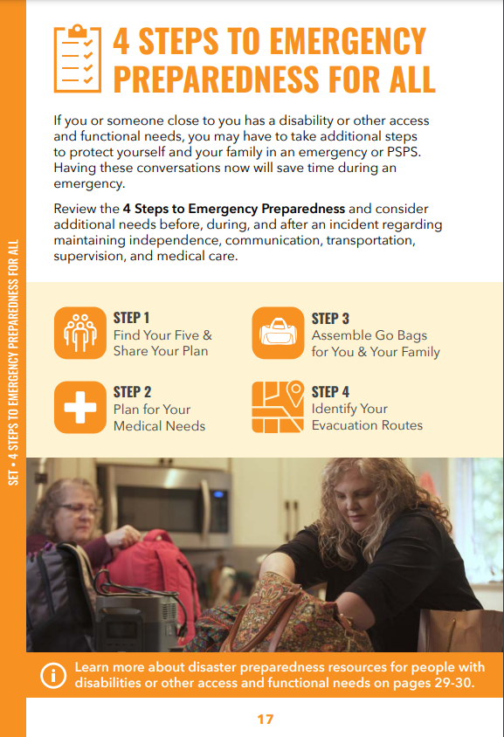
Integration
Ready, Set, Go Handbook direct mailed to all households
Integrates AFN Strategies in “Emergency Preparedness for ALL”
Highlights FREED’s Public Safety Power Shut Off Services

Slide 34
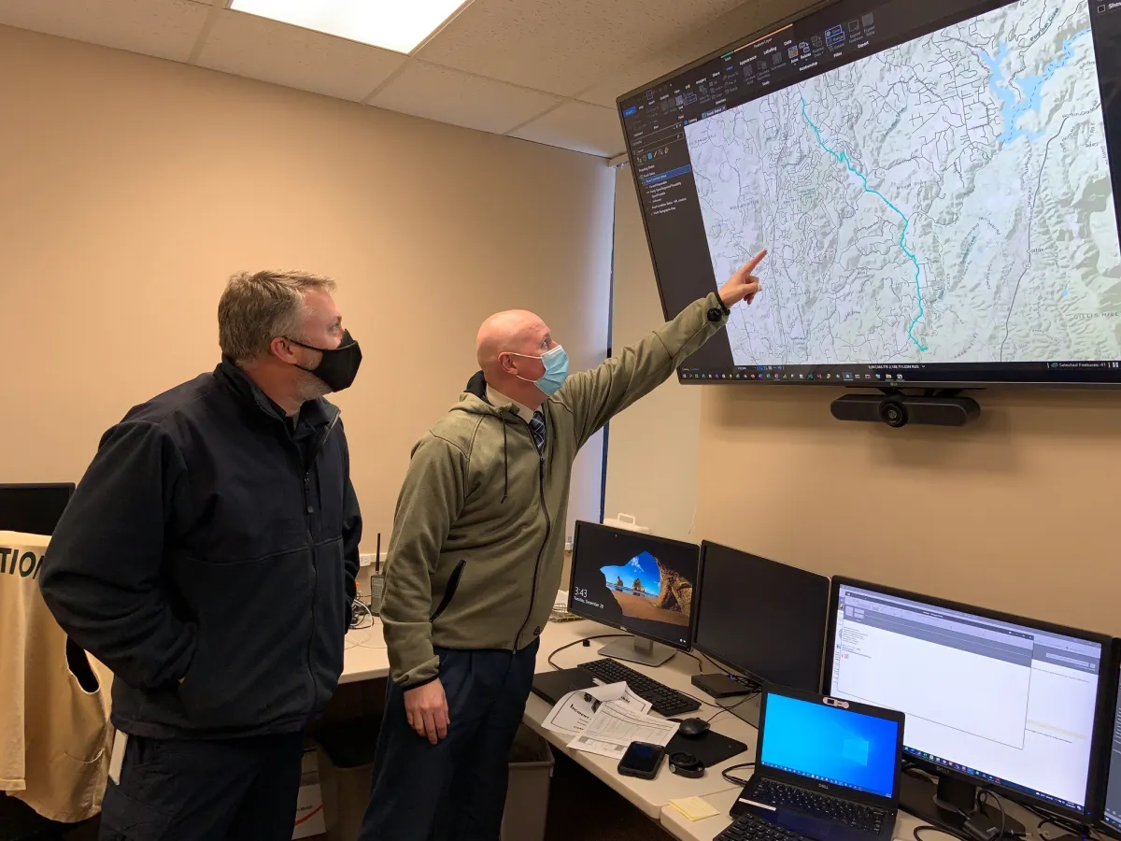
Partnership
Get seat at Emergency Operation Center
Share direct contact information across partners
Co-planning with 211, public health, county social services and OES
Shared communication system during emergency events

Slide 35
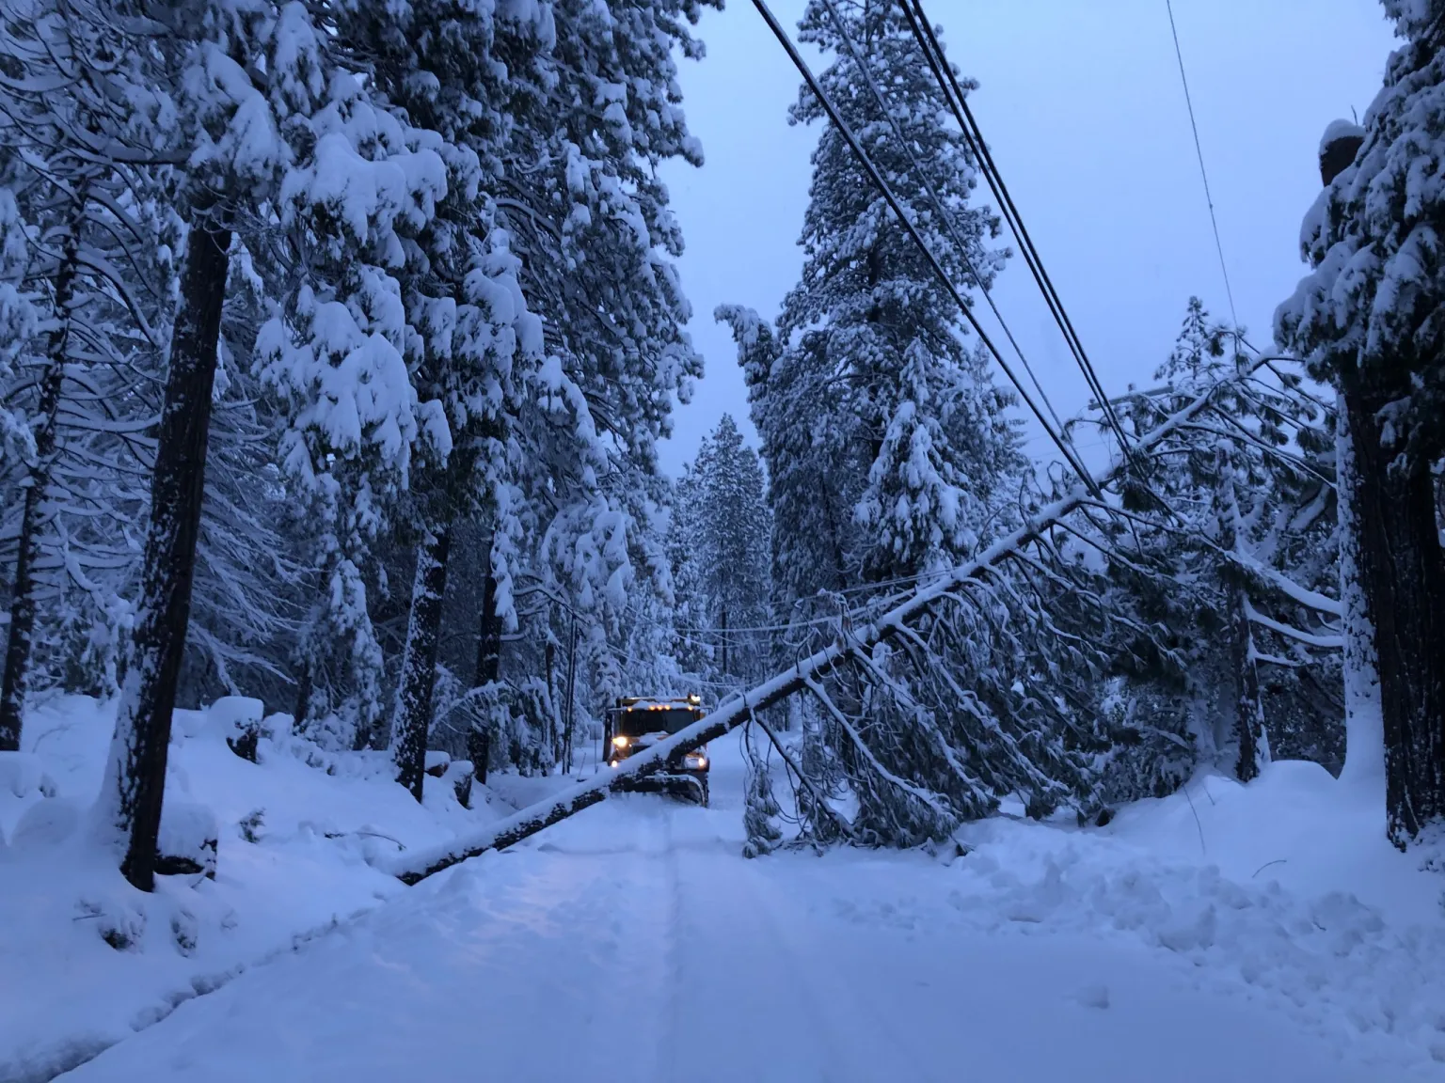
Synergy
Winter Storm 12/27-1/11
2/3 of county without power
Over 500 individual outages
Many roads blocked
Phone & internet lines down
Longest without power 16 days

Slide 36
Nevada County Event Timeline
Initial Snowfall
Addtl Snowfall
County Roads Cleared
Note: Data verification underway. Definition of “PG&E Customer” likely undercount of residents impacted. Placer County impact not included.

Slide 37
Synergy – What worked well
Phone calls from OES to share scope of challenge & establish available resources
Collaboration to obtain additional resources
Collaboration around community messaging and misinformation
Shared referral system from 211 to county and FREED
Triage information shared back with county staff clearing snow to prioritize critical issues

Slide 38
Synergy – What worked well
Communication with shelter locations to assist individuals with complex needs
Quick pivots as the needs increased as the event extended
Collaboration with Paratransit, Transit, and County staff to assist with transportation
Reassigned county staff to support 211, door to door check-ins and resources for mobile home residents

Slide 39
FREED Services Provided 12/27/21-1/13/2022
Across Nevada, Placer, El Dorado, Yuba Counties
Received 917 requests for service
Provided 82 hotel rooms for 165 individuals
Provided transportation to hotels for 8 individuals
Provided 725 food vouchers for individuals in hotels and those with specific dietary needs that lost food
Provided 574 gas vouchers to keep generators running and support propane purchases

Slide 40
Synergy – What we learned
Need for community partners to attend daily county briefing
Additional partners joining monthly OES/FREED coordination meeting
CBO liaison position in EOC to be created
County IT staff to support development of a new collaborative tool
Development of a VOAD (Voluntary Organizations Active In Disaster)

